Slide 1
SYMPTOM-BASED AILMENT PROPHESY USING MACHINE LEARNING APPROACH WITH GUI
RITHIKSHARVESH KS

Slide 2
OVERVIEW
ABSTRACT
INTRODUCTION/PROLOGUE
METHODOLOGY
PERFORMANCE ANALYSIS
INFERENCE
CONCLUSION
REFERENCE

Slide 3
ABSTRACT
Background - Health is one of the most vital aspects of existence.
It might be difficult for some people to visit a doctor every time they experience discomfort.
Objective - Forecasting the disease based on symptoms.
GUI will be provided to users to select the symptoms.
The final outcome will be displayed based on four ML techniques.

Slide 4
INTRODUCTION/PROLOGUE
Health is one of the uncompromising integrity factor as it is the essence that drives people to lead a productive life.
Many individuals lack the expertise to diagnose an illness based on its symptoms.
The suggested method produces an attractive Graphical User Interface that include symptoms
Naive Bayes, Decision trees, Random Forest algorithms and Support Vector Machine are employed to predict illness based on the symptoms experienced by individuals.
The most prevalent illness will be taken into account as the outcome.

Slide 5
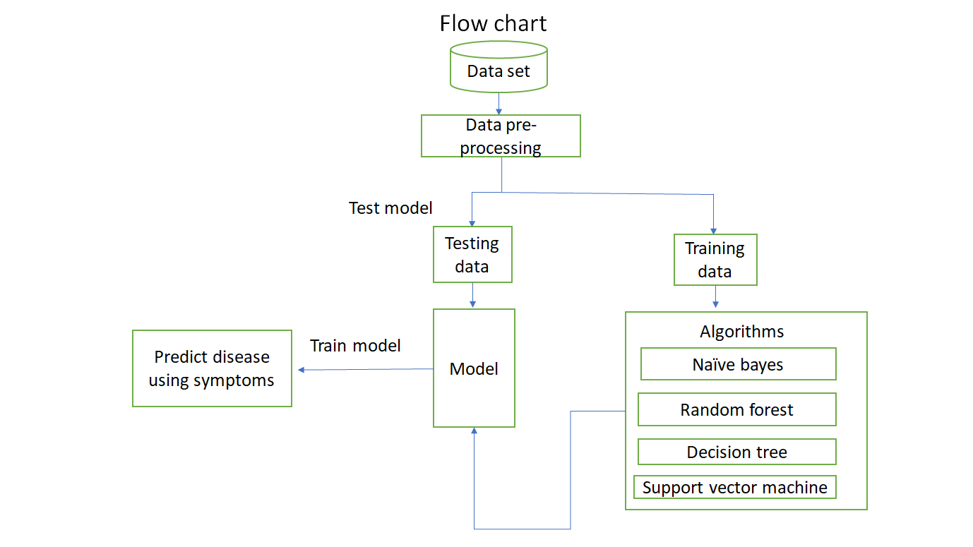
METHODOLOGY

Slide 6
DATASET ELUCIDATION
SOURCE: Kaggle
ABOUT: DISEASE PREDICTION USING MACHINE LEARNING
COMPRISES: 2 CSV files, Training data and Testing data.
132 Symptoms(features) mapped to 26 Diseases

Slide 7
DATA-PREPROCESSING
DATA INTEGRATION
DATA TRANSFORMATION
DATA REDUCTION
DATA CLEANING

Slide 8
TRAINING DATA
TESTING DATA
Training data is the subset of original data that is used to train the machine learning model.
Testing data is used to check the accuracy of the model.

Slide 9
ALGORITHMS
DECISION TREES – Classification Algorithm
RANDOM FOREST
NAÏVE BAYES
SUPPORT VECTOR MACHINE
Prediction

Slide 10

PERFORMANCE ANALYSIS
ALGORITHM | ACCURACY
DECISION TREE | 96%
RANDOM FOREST CLASSIFIER | 97%
NAÏVE BAYES | 94%
SUPPORT VECTOR MACHINE | 98.8%

Slide 11
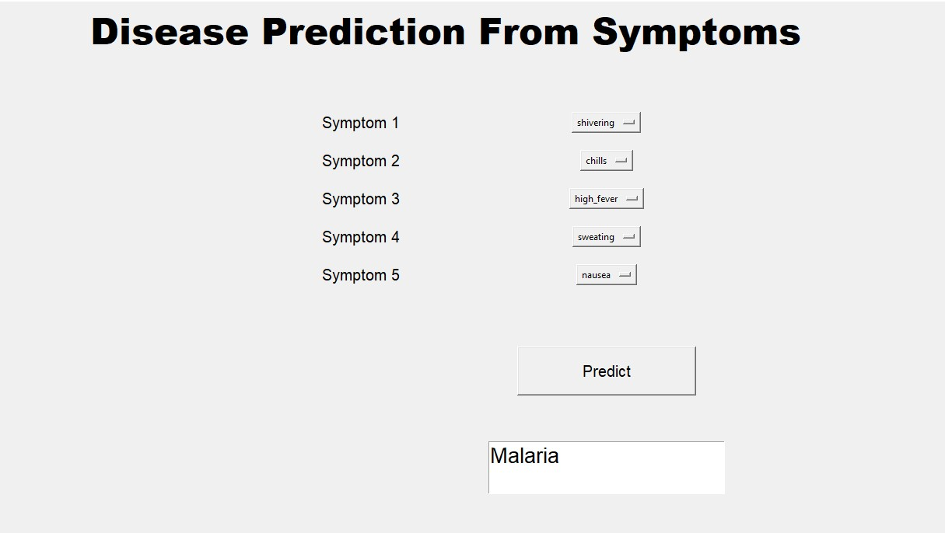
INFERENCE

Slide 12
CONCLUSION
This proposed model analyses the symptoms entered by the user and predicts the disease based on those symptoms.
Existing models have an accuracy of only 80%, and our model has a 95% accuracy rate.
An evaluation of the system's outcomes on a larger dataset will be conducted in the future.
It is also possible to include the capability of recommending Doctors or Hospitals for the predicted illness.

Slide 13
REFERENCES
Bhatt, C. M., Patel, P., Ghetia, T., & Mazzeo, P. L. (2023, February 6). Effective Heart Disease Prediction Using Machine Learning Techniques. Algorithms, 16(2), 88. https://doi.org/10.3390/a16020088
Chen, M., Hao, Y., Hwang, K., Wang, L., & Wang, L. (2017). Disease Prediction by Machine Learning Over Big Data From Healthcare Communities. IEEE Access, 5, 8869–8879. https://doi.org/10.1109/access.2017.2694446
Dahiwade, D., Patle, G., & Meshram, E. (2019, March). Designing Disease Prediction Model Using Machine Learning Approach. 2019 3rd International Conference on Computing Methodologies and Communication (ICCMC). https://doi.org/10.1109/iccmc.2019.8819782
Grampurohit, S., & Sagarnal, C. (2020, June). Disease Prediction using Machine Learning Algorithms. 2020 International Conference for Emerging Technology (INCET). https://doi.org/10.1109/incet49848.2020.9154130
Hema, P., Sunny, N., Venkata Naganjani, R., & Darbha, A. (2022, April). Disease Prediction using Symptoms based on Machine Learning Algorithms. 2022 International Conference on Breakthrough in Heuristics and Reciprocation of Advanced Technologies (BHARAT). https://doi.org/10.1109/bharat53139.2022.00021
Katarya, R., & Meena, S. K. (2020, November 19). Machine Learning Techniques for Heart Disease Prediction: A Comparative Study and Analysis. Health and Technology, 11(1), 87–97. https://doi.org/10.1007/s12553-020-00505-7

